Slide 1
Final capstone project
By Tim Scherman

Slide 2
background
Purpose of report is to analyze the difference between styles of play between NBA championship teams throughout the years
Analysis begins in 1980 because that was the year the NBA fully enacted the three point shot
Final conclusion will include suggestions for specific trends to look at when betting on teams to win the NBA title

Slide 3

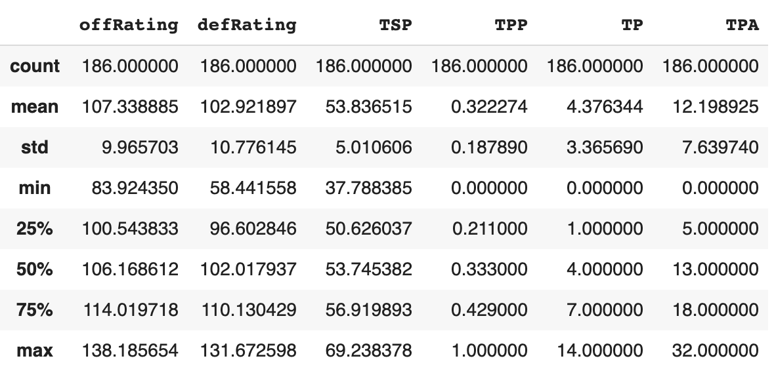
Early nba descriptive statistics: 1980-2012
offRating = offensive efficiency
defRating = defensive efficiency
TSP = true shooting percentage
TPP = three point percentage
TP = three pointers made
TPA = three pointers attempted

Slide 4
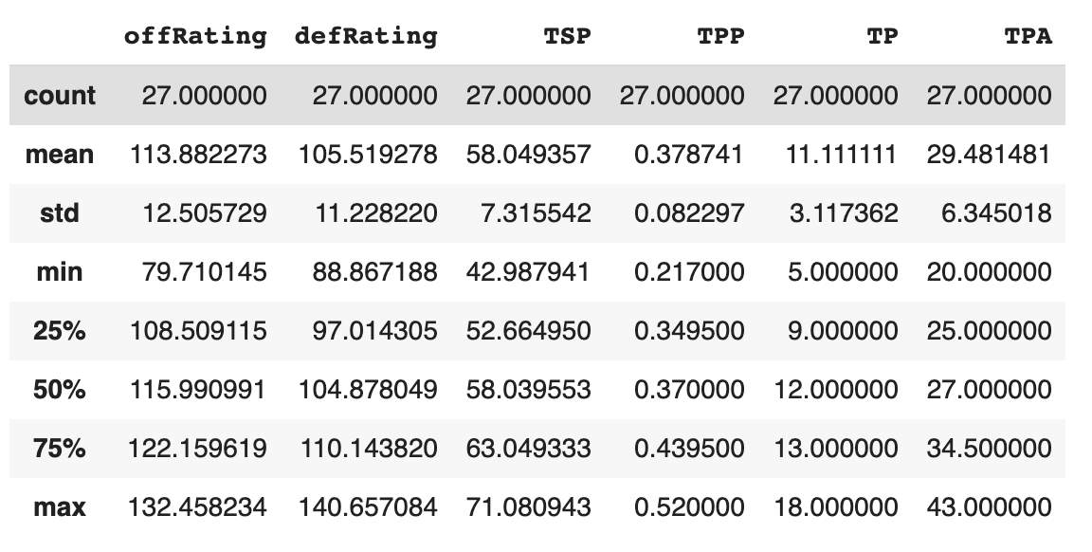
Modern nba descriptive statistics: 2013-present
offRating = offensive efficiency
defRating = defensive efficiency
TSP = true shooting percentage
TPP = three point percentage
TP = three pointers made
TPA = three pointers attempted

Slide 5
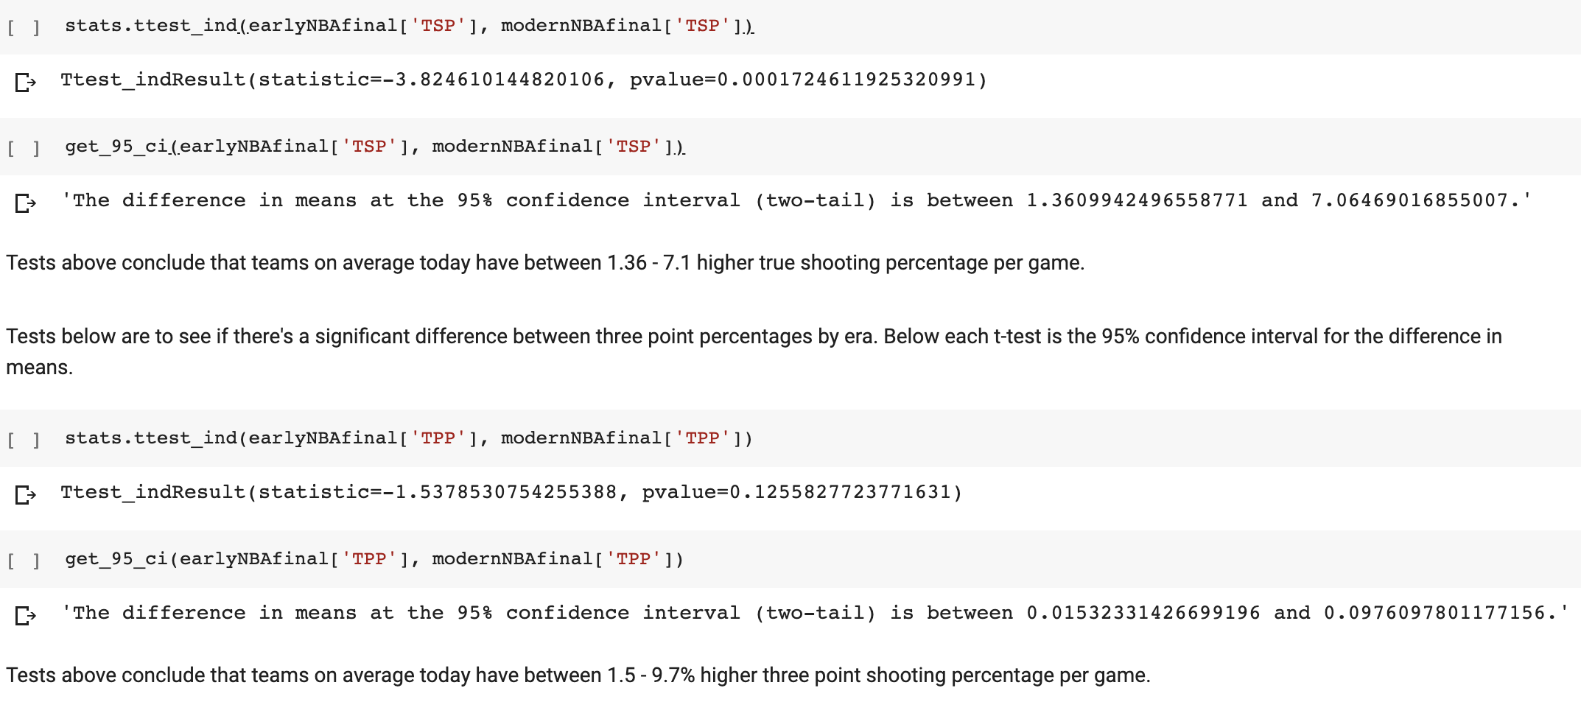

T-tests for significant difference in true shooting percentage and three point percentage means

Slide 6
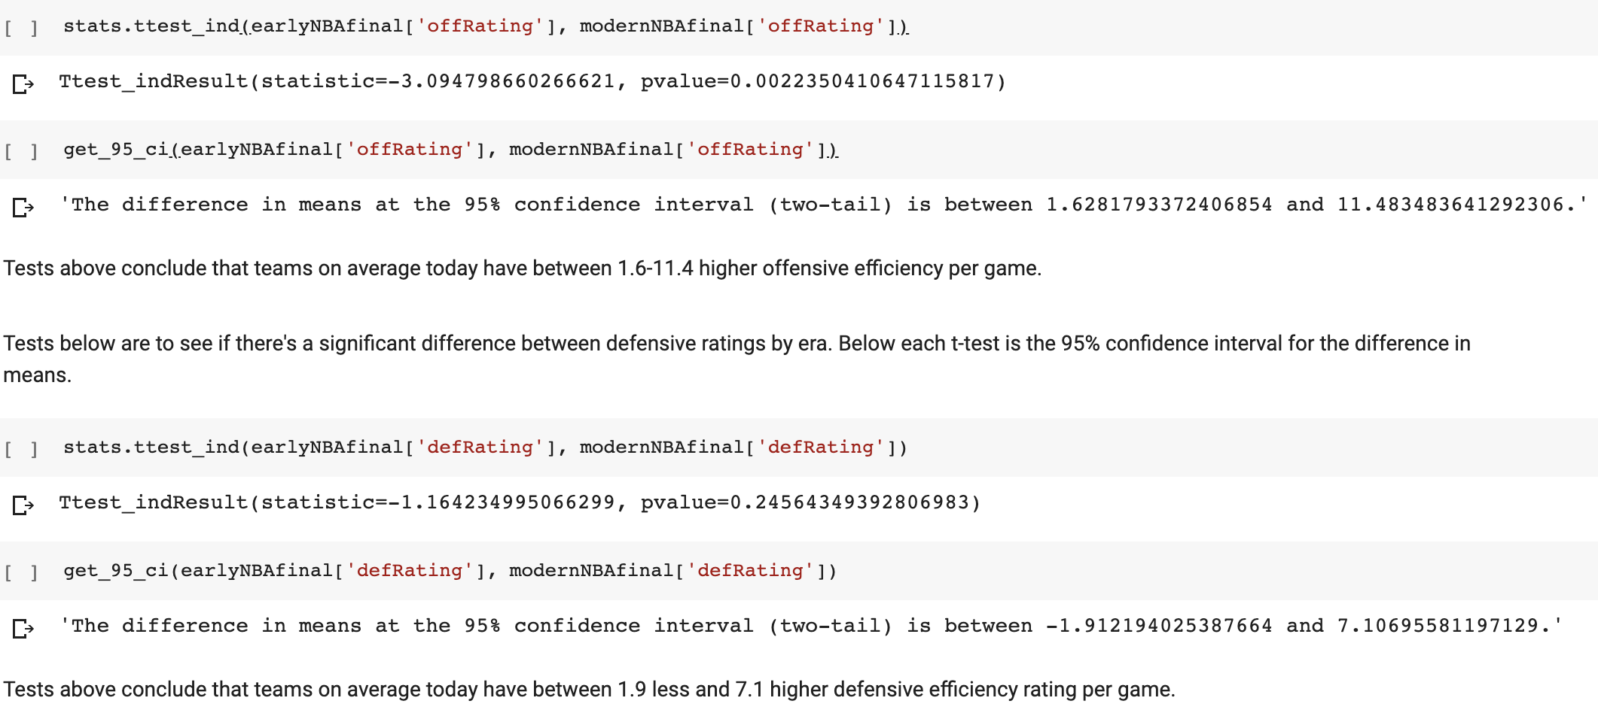
T-tests for significant difference in offensive/defensive efficiency means

Slide 7
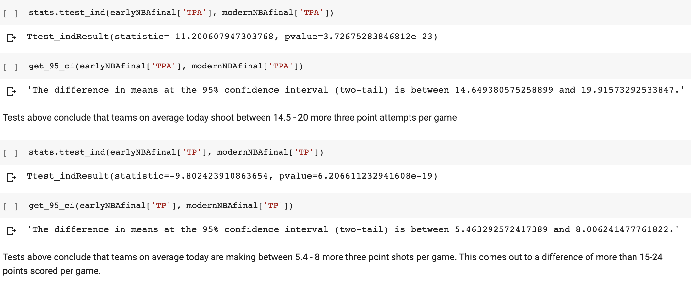
T-tests for significant difference in average three point attempts and three pointers made

Slide 8
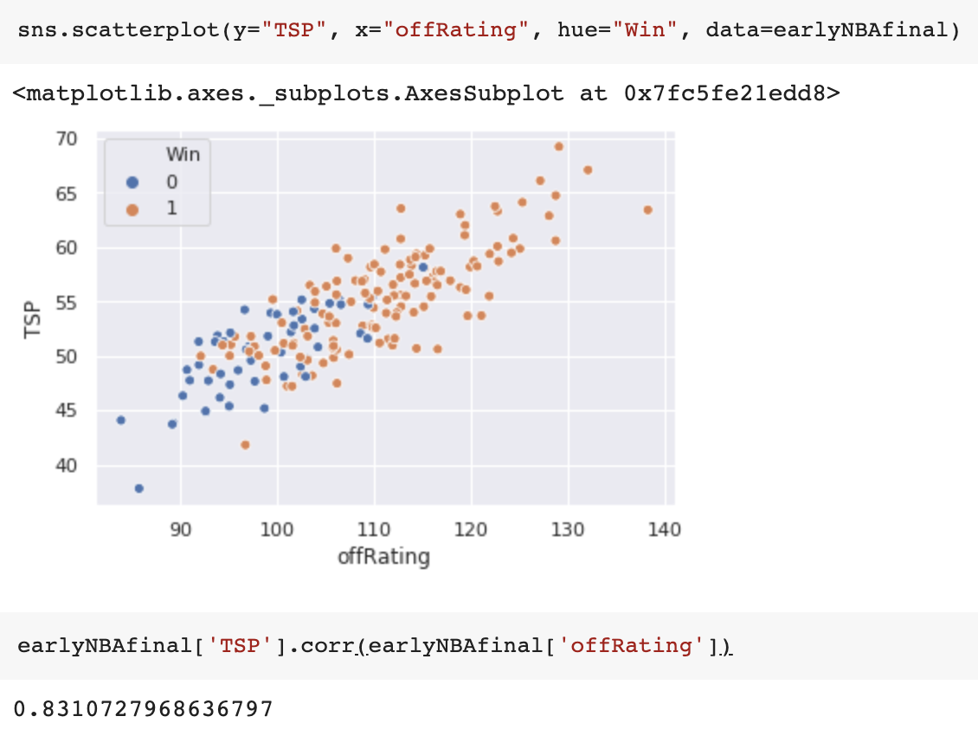
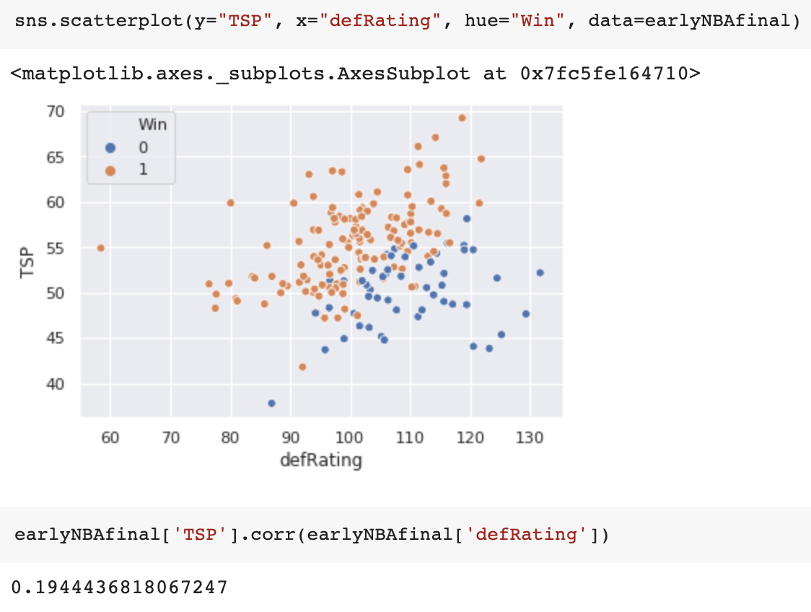
Early Nba Scatter plots testing correlation between tsp and off/def rating

Slide 9
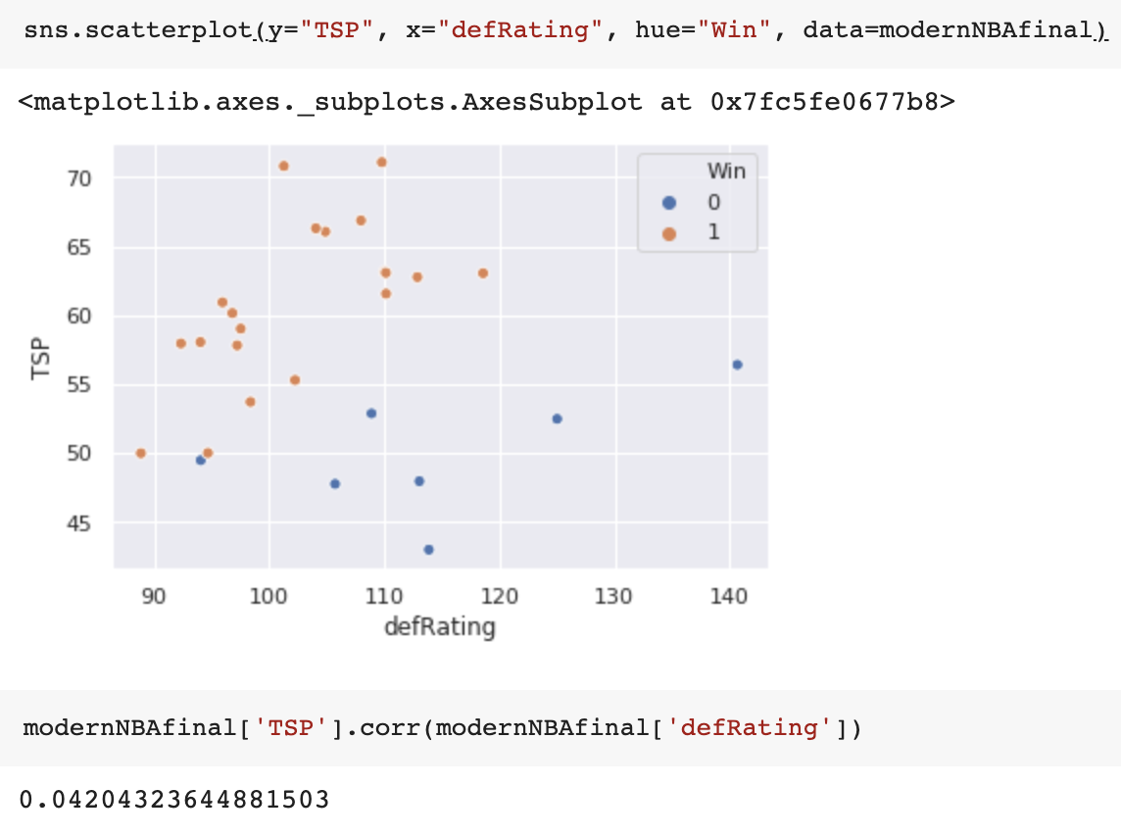
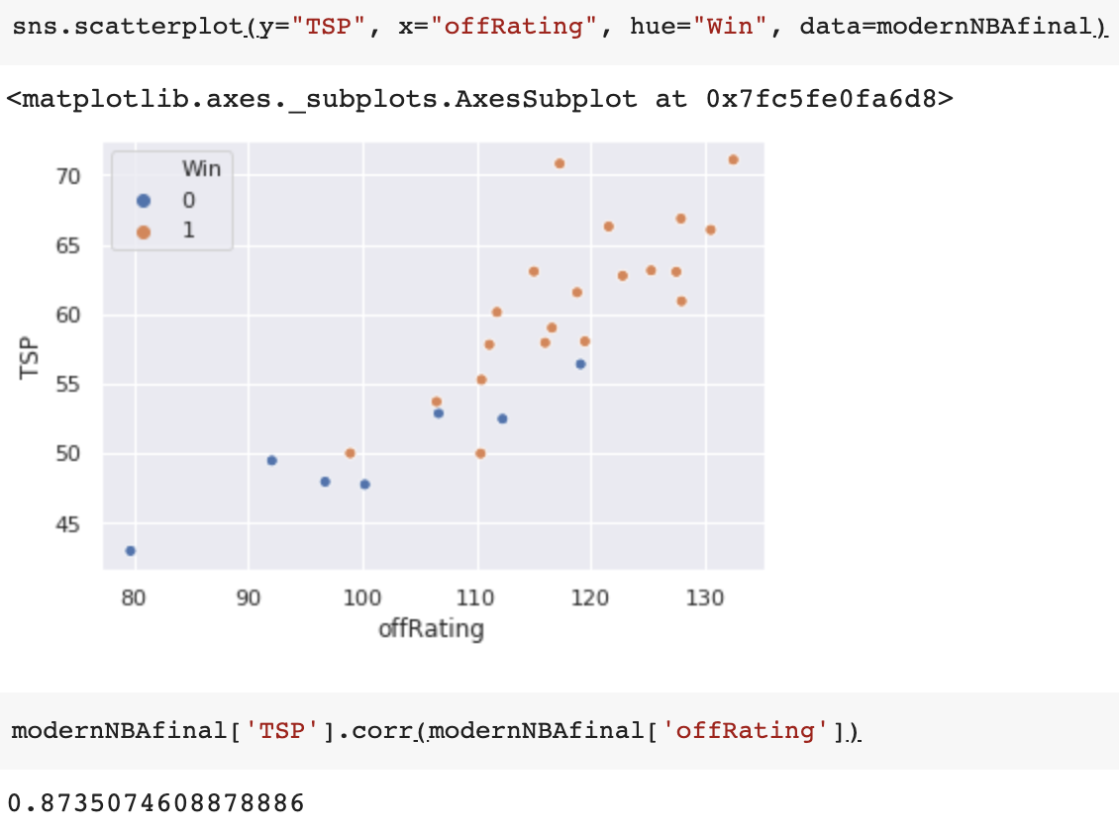
modern Nba Scatter plots testing correlation between tsp and off/def rating

Slide 10
Conclusion
Proved hypothesis of championship teams employing a more offensive approach to winning games in new era
Sacrificing defense for more offense does not have drastic effects to a team winning a game
Proved hypothesis of team’s frequency of shooting three pointers over the years has increased exponentially
Three point attempts have gone up significantly
Rate at which they’re being made is up 7%, which in field goal percentage and between 5 and 14 more three point shots are being made per game
Findings have shown that the emphasis on shooting and offensive efficiency are the ways in which teams are coming out as champions
While defense will never go out in any sport, it cannot be argued that a team's focus should be on their offensive abilities in order to win it all in the NBA.

